Slide 1


SPRING VALLEY VILLAGE POLICE DEPARTMENT
MONTHLY NEWSLETTER:
AUGUST 2025
1025 CAMPBELL ROAD
HOUSTON, TX 77055
PHONE: 713-465-8323
COMMUNITY MATTERS.
WE ARE A TEAM.

Slide 2

INTRODUCTION
Hilshire Village Residents,
We wanted to wish all the students a great 2025‐2026 school year. Spring Valley Village Police Department wants you to have fun while staying safe. Please be vigilant and observant of your surroundings, wherever you are. Remember: See Something, Say Something.
KEEP IN MIND:
  Be sure to lock all doors and windows in your home, when you are not on the premises.
  Lock your vehicle when it is unoccupied.
As always we are here if you need us!
Sincerely,
Chief M. Schulze
1025 CAMPBELL ROAD, HOUSTON, TX 77055
PHONE: 713-465-8323 / EMAIL: DISPATCH@SPRINGVALLEYTX.COM

Slide 3

AUGUST 2025
DATE | DAY | SPECIAL DAYS FOR THIS MONTH
08-15-2025 | WEDNESDAY | FIRST DAY OF SCHOOL
COMMUNITY MATTERS.
WE ARE A TEAM.
Helpful Links to Spring Branch Independent School District:
SBISD Website: https://www.springbranchisd.com/
SBISD Link to Printable Academic Calendar for 2023-2024 :
www. https://www.springbranchisd.com/about/calendars
1025 CAMPBELL ROAD, HOUSTON, TX 77055 / PHONE: 713-465-8323 / EMAIL: DISPATCH@SPRINGVALLEYTX.COM

Slide 4

KEEP IN MIND:
COMMUNITY MATTERS.
WE ARE A TEAM.
1025 CAMPBELL ROAD, HOUSTON, TX 77055 / PHONE: 713-465-8323 / EMAIL: DISPATCH@SPRINGVALLEYTX.COM

Slide 5
Summer Safety Tips:
Heat-Related Emergencies
  Always, make sure you “Look Before They Lock”. Do not leave children, senior citizens, or pets unattended in a vehicle.
  Conduct outdoor work or exercise in the early morning or evening when it is cooler.
  A wide-brimmed, loose-fitting hat that allows ventilation helps prevent sunburn and heat-related emergencies. Sunscreen also helps protect injury from the sun's rays and reduces the risk of sunburn.
Sgt. B. Alvarado
Common Heat-Related Medical Emergencies
Be Aware of your symptoms as well as those around you. You and your family and friends may not realize they are becoming overheated.
  Heat Exhaustion – Signs include profuse sweating, paleness, muscle cramps, weakness, dizziness, headache, nausea or vomiting, a weak-but-rapid pulse, and fainting. The skin may be cool and moist. If heat exhaustion is untreated, it may progress to heat stroke.
  Heat Stroke – Heat stroke occurs when the body’s temperature rises rapidly, the sweating system fails, and the body is unable to cool down. Symptoms include an extremely high body temperature (above 103°F, orally), red, hot, and dry skin (no sweating), rapid and strong pulse, throbbing headache, dizziness, nausea, confusion, and unconsciousness.
Officer F. McClain
COMMUNITY MATTERS.
WE ARE A TEAM.
1025 CAMPBELL ROAD, HOUSTON, TX 77055 / PHONE: 713-465-8323 / EMAIL: DISPATCH@SPRINGVALLEYTX.COM

Slide 6
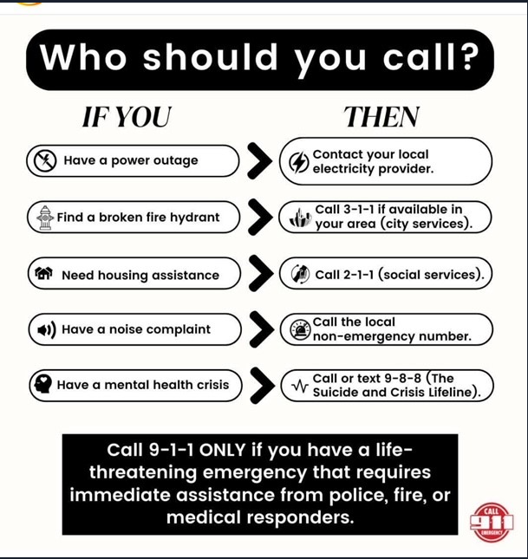
1025 CAMPBELL ROAD, HOUSTON, TX 77055
PHONE: 713-465-8323 / EMAIL: DISPATCH@SPRINGVALLEYTX.COM

Slide 7
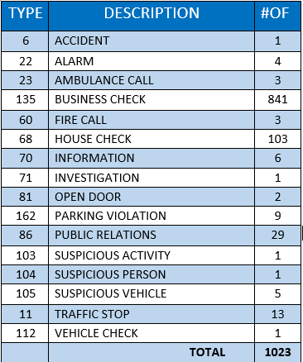
SPRING VALLEY POLICE DEPARTMENT
HILSHIRE VILLAGE
CALLS BY TYPE: 07/01/25 THRU 07/31/25
COMMUNITY MATTERS.
WE ARE A TEAM.
1025 CAMPBELL ROAD, HOUSTON, TX 77055
PHONE: 713-465-8323 / EMAIL: DISPATCH@SPRINGVALLEYTX.COM

Slide 8
IMPORTANT NUMBERS AT A GLANCE
EMERGENCY |  | NON - EMERGENCY
911 - FOR ALL EMERGENCY |  | 713-465-8323
988 – NATIONAL SUICIDE & MENTAL HEALTH
SPRING VALLEY VILLAGE |  | VILLAGE FIRE DEPARTMENT
SPRING VALLEY - CITY HALL | 713-465-8308 | VILLAGE FIRE DEPARTMENT |  | 713-465-2323
SPRING VALLEY - PD | 713-465-8323 | VFD - NON-EMERGENCY |  | 713-468-7941
SPRING VALLEY - PD FAX | 713-465-3135
SPRING VALLEY - COURT | 713-465-0333
HILSHIRE VILLAGE
HILSHIRE VILLAGE – CITY HALL | 713-973-1779
COMMUNITY MATTERS.
WE ARE A TEAM.
1025 CAMPBELL ROAD, HOUSTON, TX 77055 / PHONE: 713-465-8323 / EMAIL: DISPATCH@SPRINGVALLEYTX.COM

